Slide 1


Slide 2
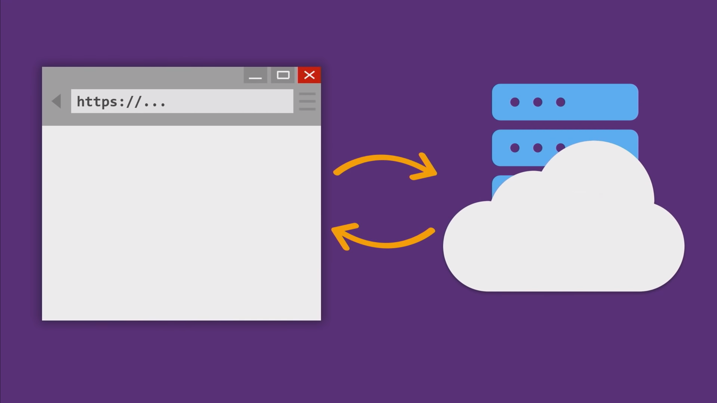
Notes:
.NET has long story to run on server or server side, initially only on windows but now on any machine. That server returns response in json, html in response to browser requests.

Slide 3
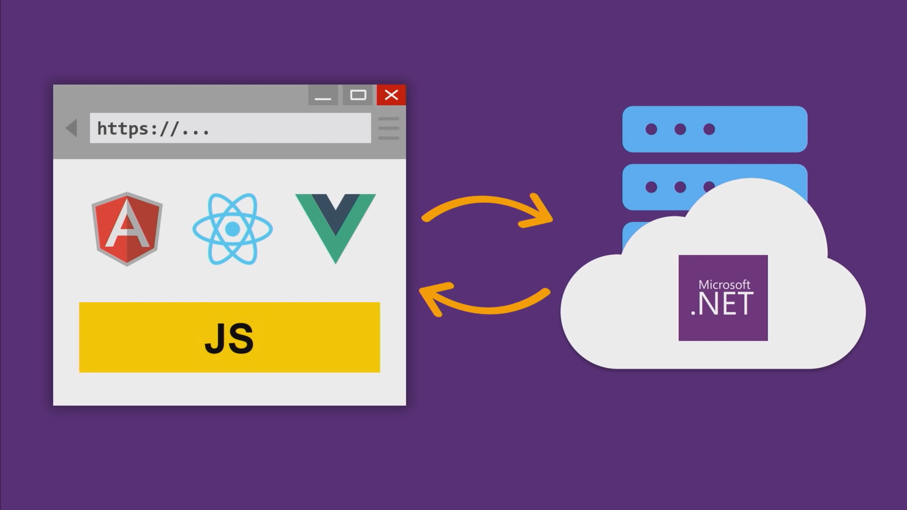
Notes:
If you want to do anything on client or browser we had to use these JS guys. So JS and C# because very different world, and it was challenging for C# developer to write client side code. Now, that’s no longer the case because we have Blazor.

Slide 4
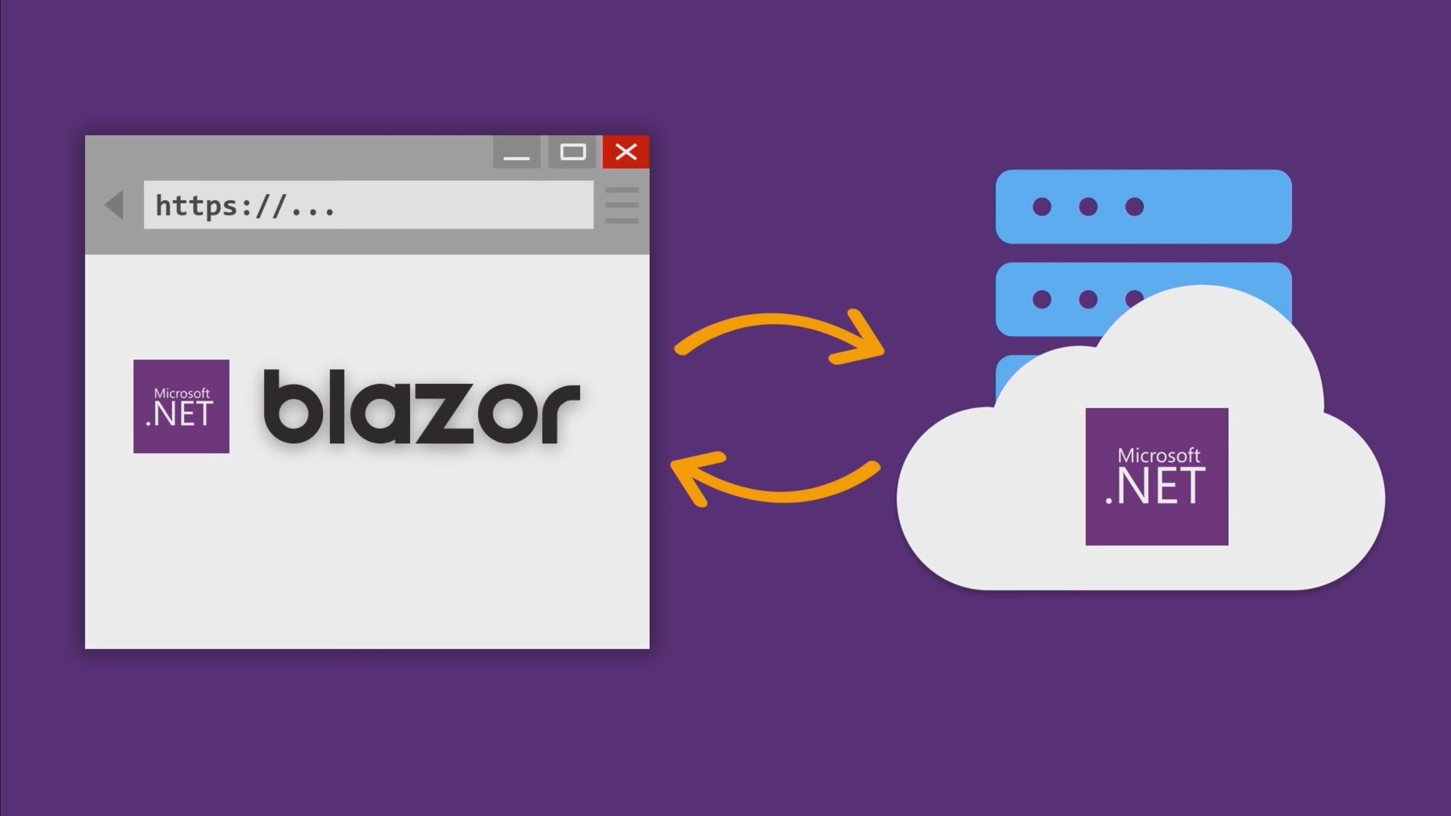
Notes:
You can now write your client side code in .NET, C# using Blazor. Please do not misunderstand that Blazor is replacing JavaScript. It is not and should not in future. It is just another way of writing client side code in the language you love that is .NET, C#.

Slide 5
Blazor is a .NET web UI framework which uses C#, Razor and HTML and runs in the browser with WebAssembly.

Slide 6
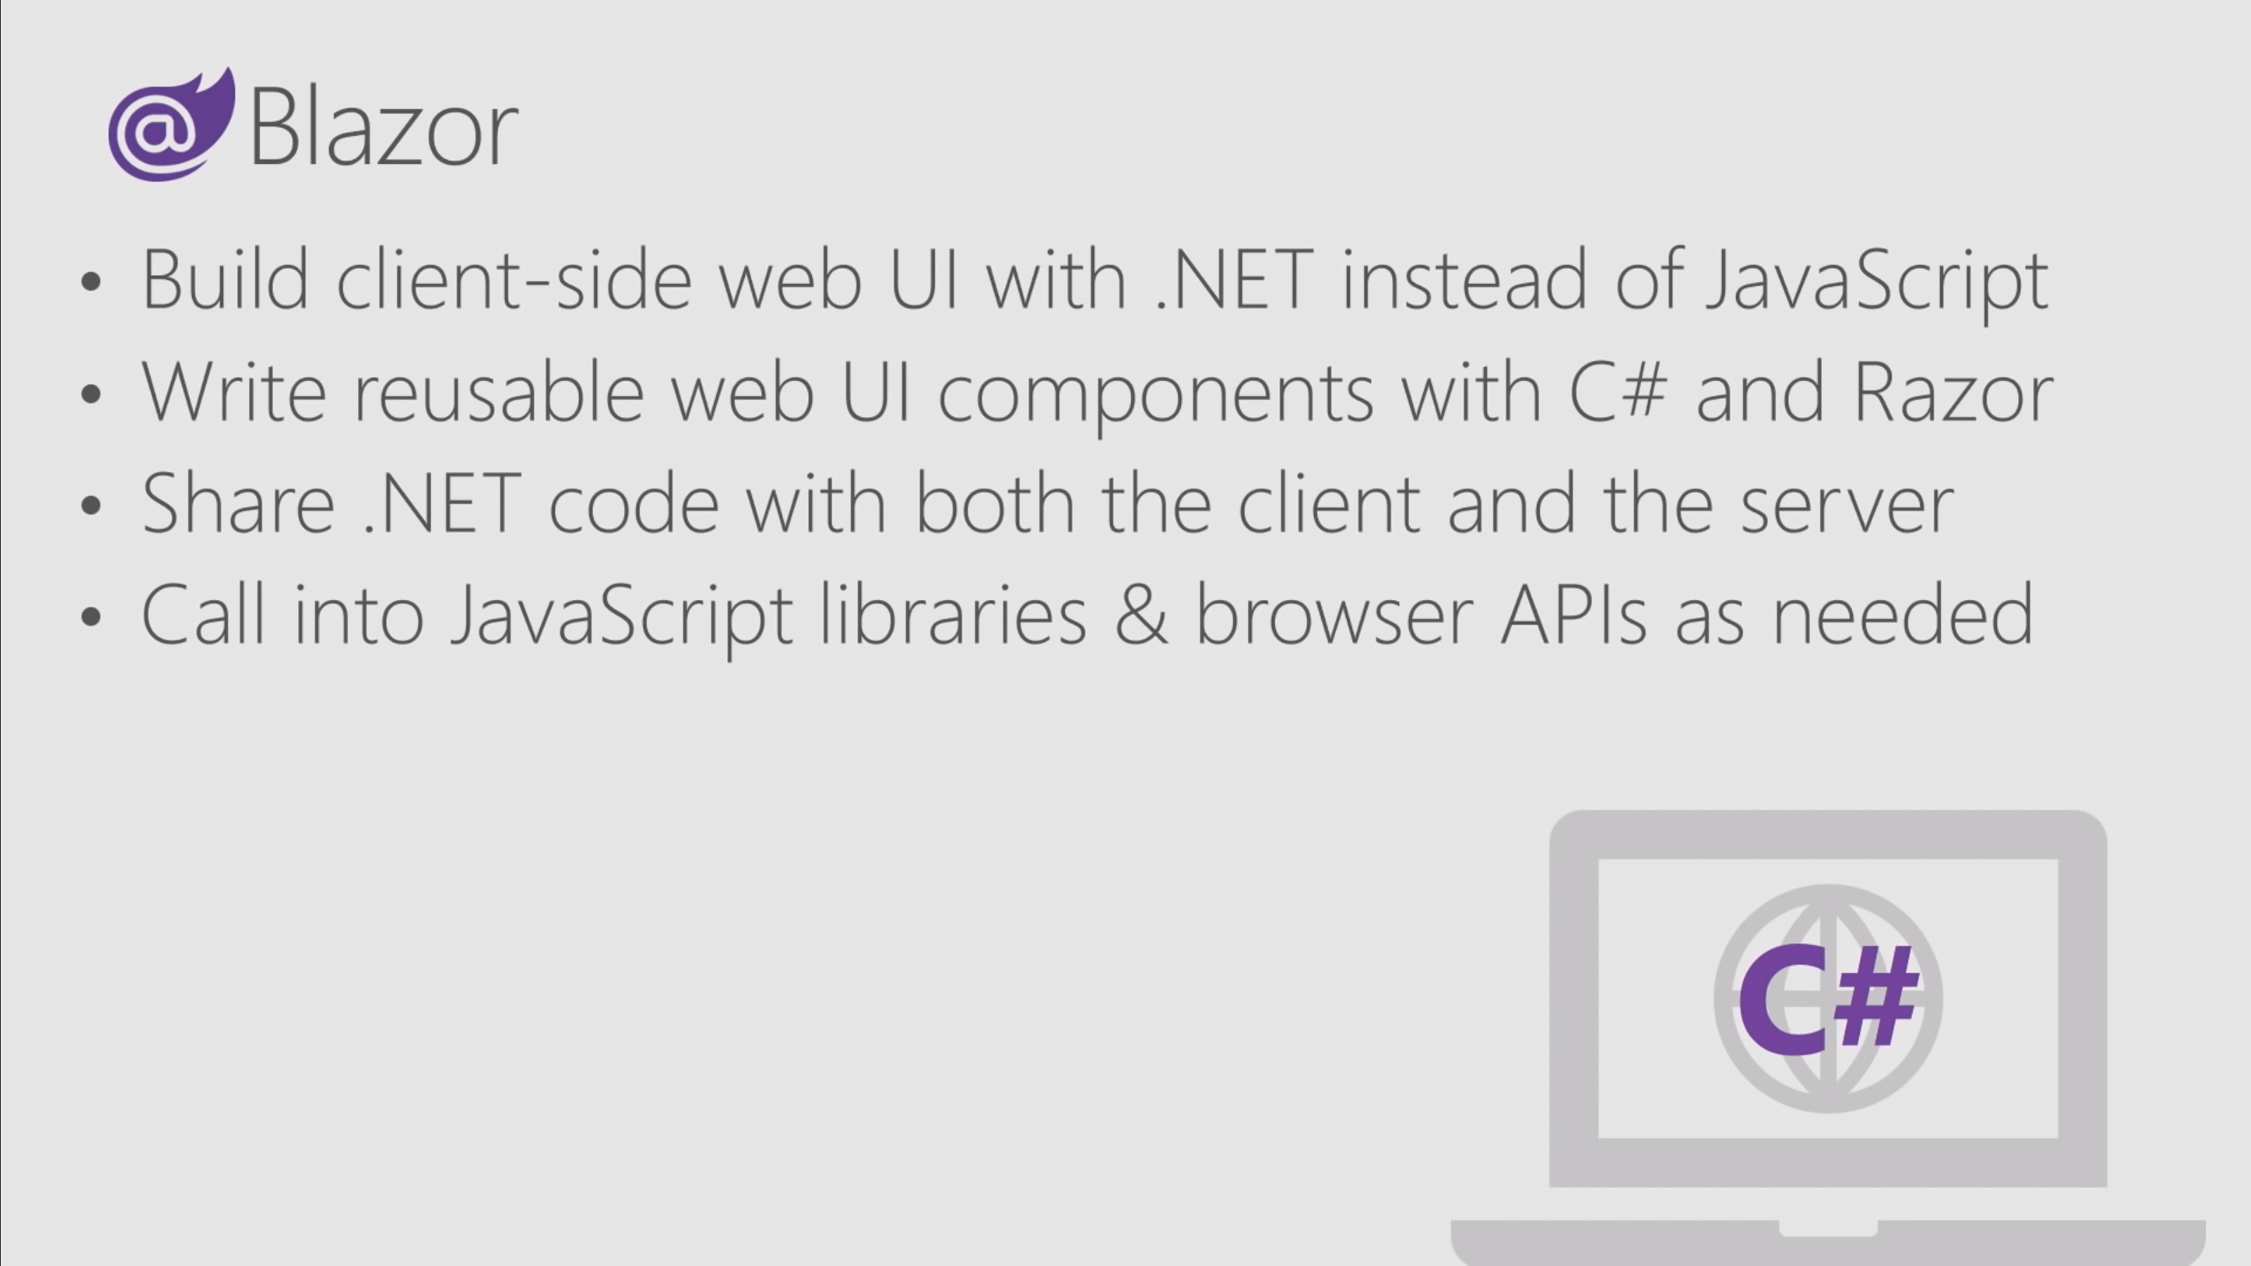

Slide 7


Slide 8



Slide 10
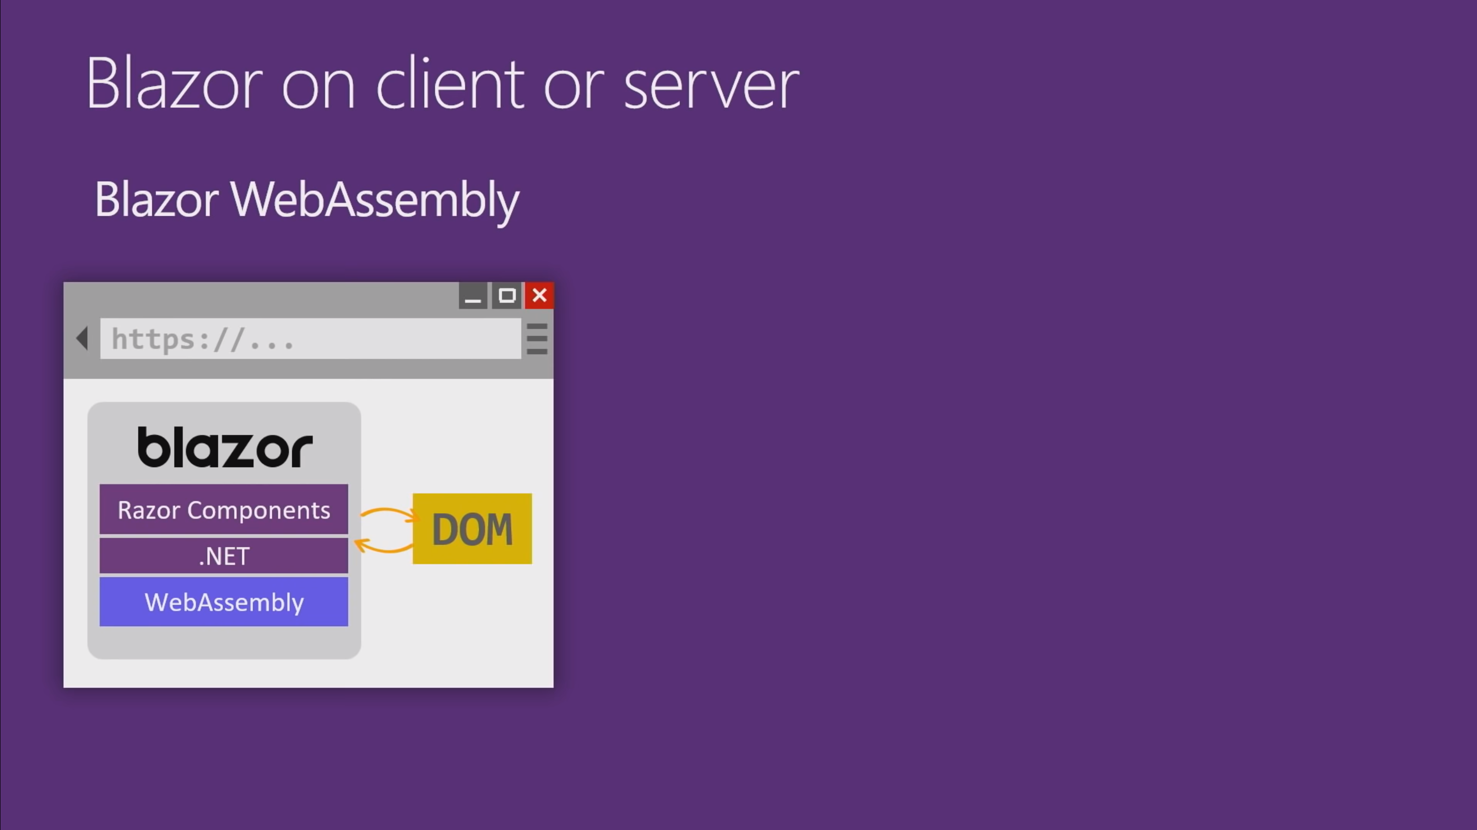

Slide 11
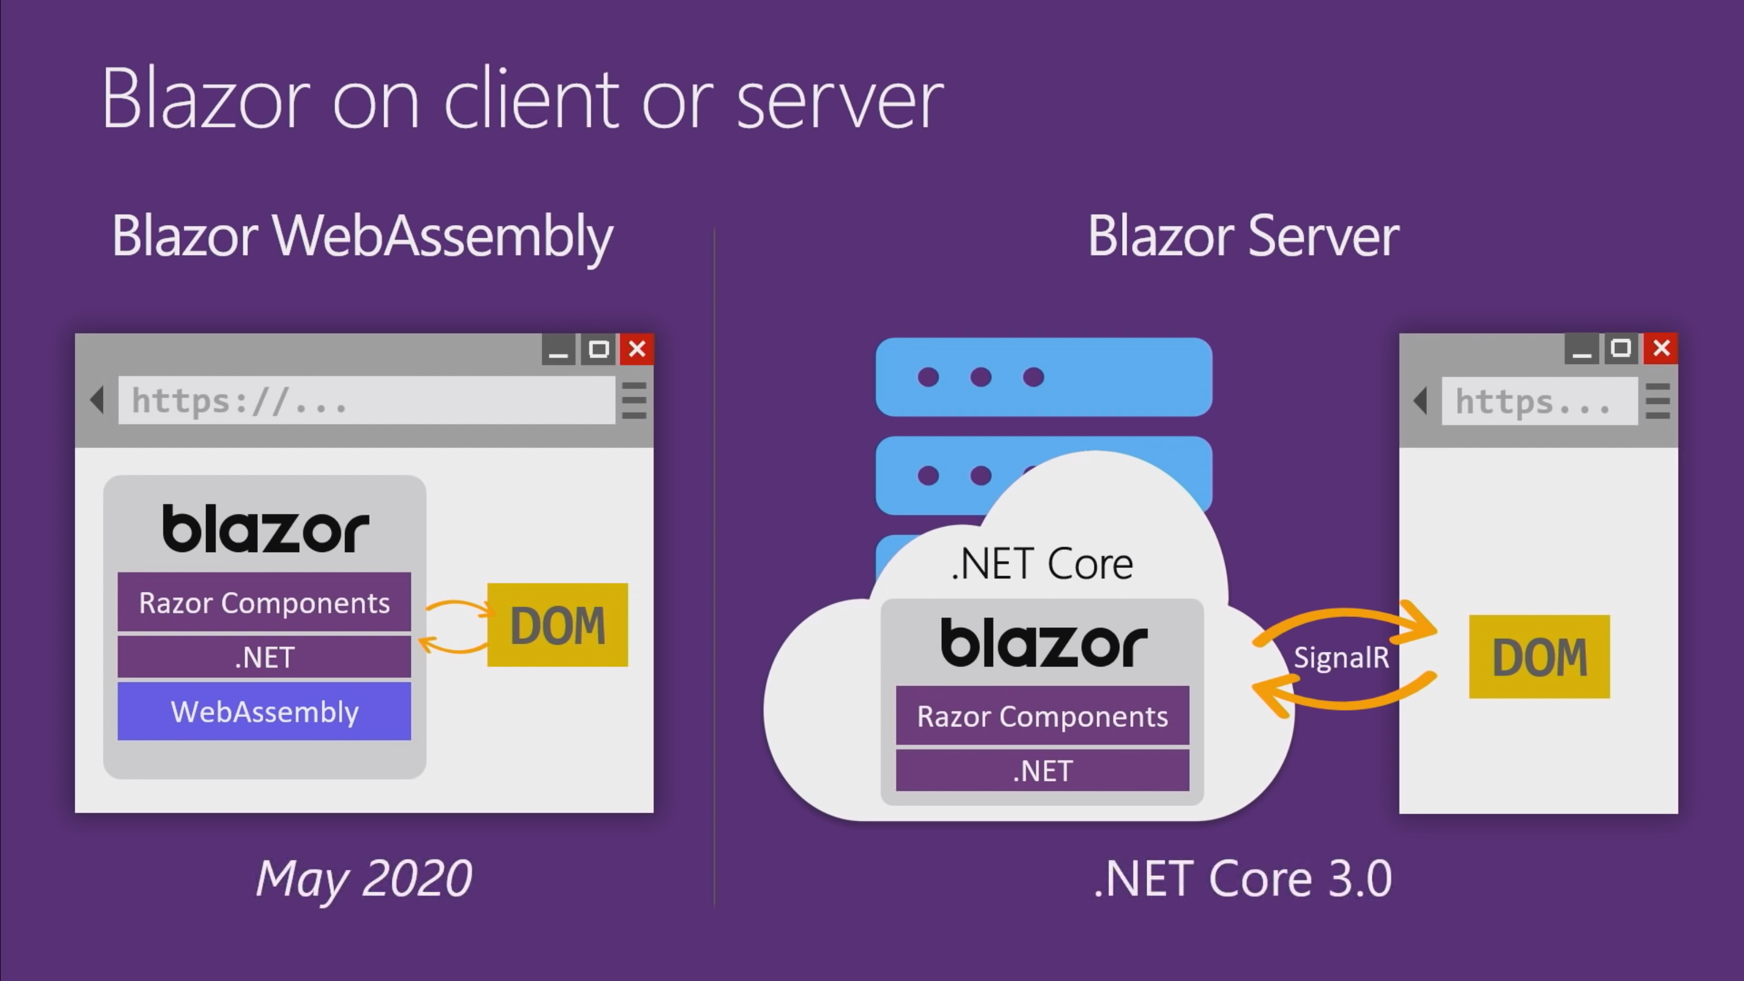

Slide 12
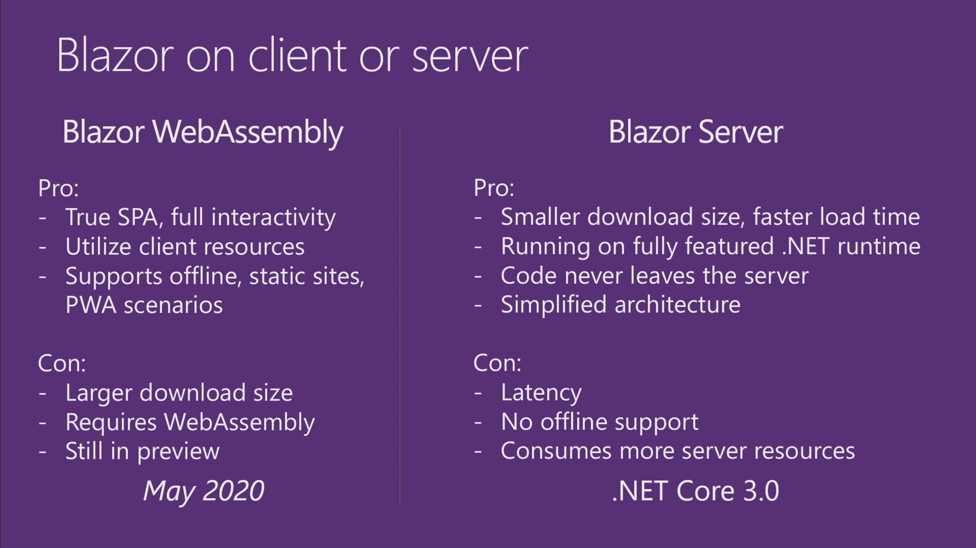

Slide 13

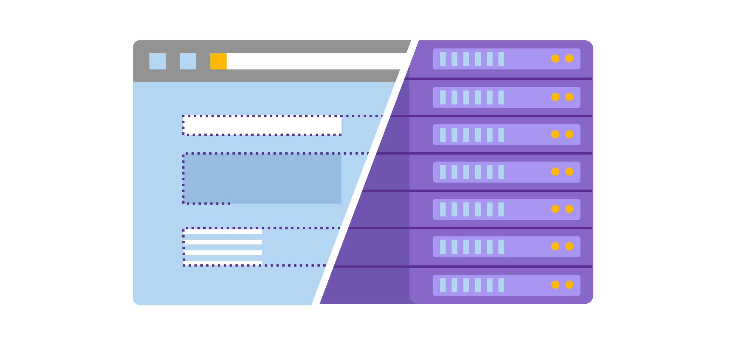
Blazor WebAssembly
when WebAssembly running on browser
Blazor Server
when WebAssembly running on server
through SignalR Hub

Slide 14
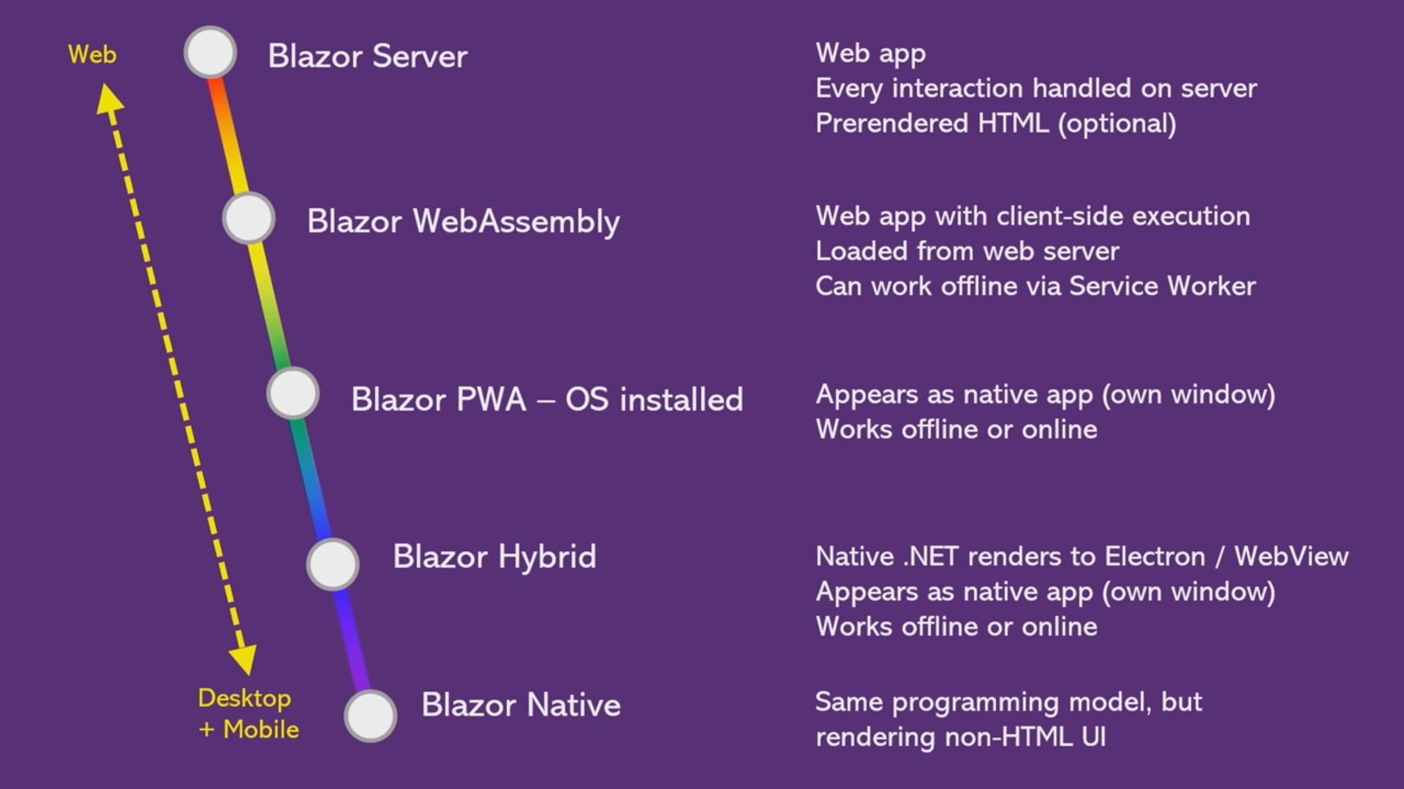
Released with .NET Core 3
In Preview (expected release March 2020)
Experimental stage
Experimental stage
Experimental stage

Slide 15
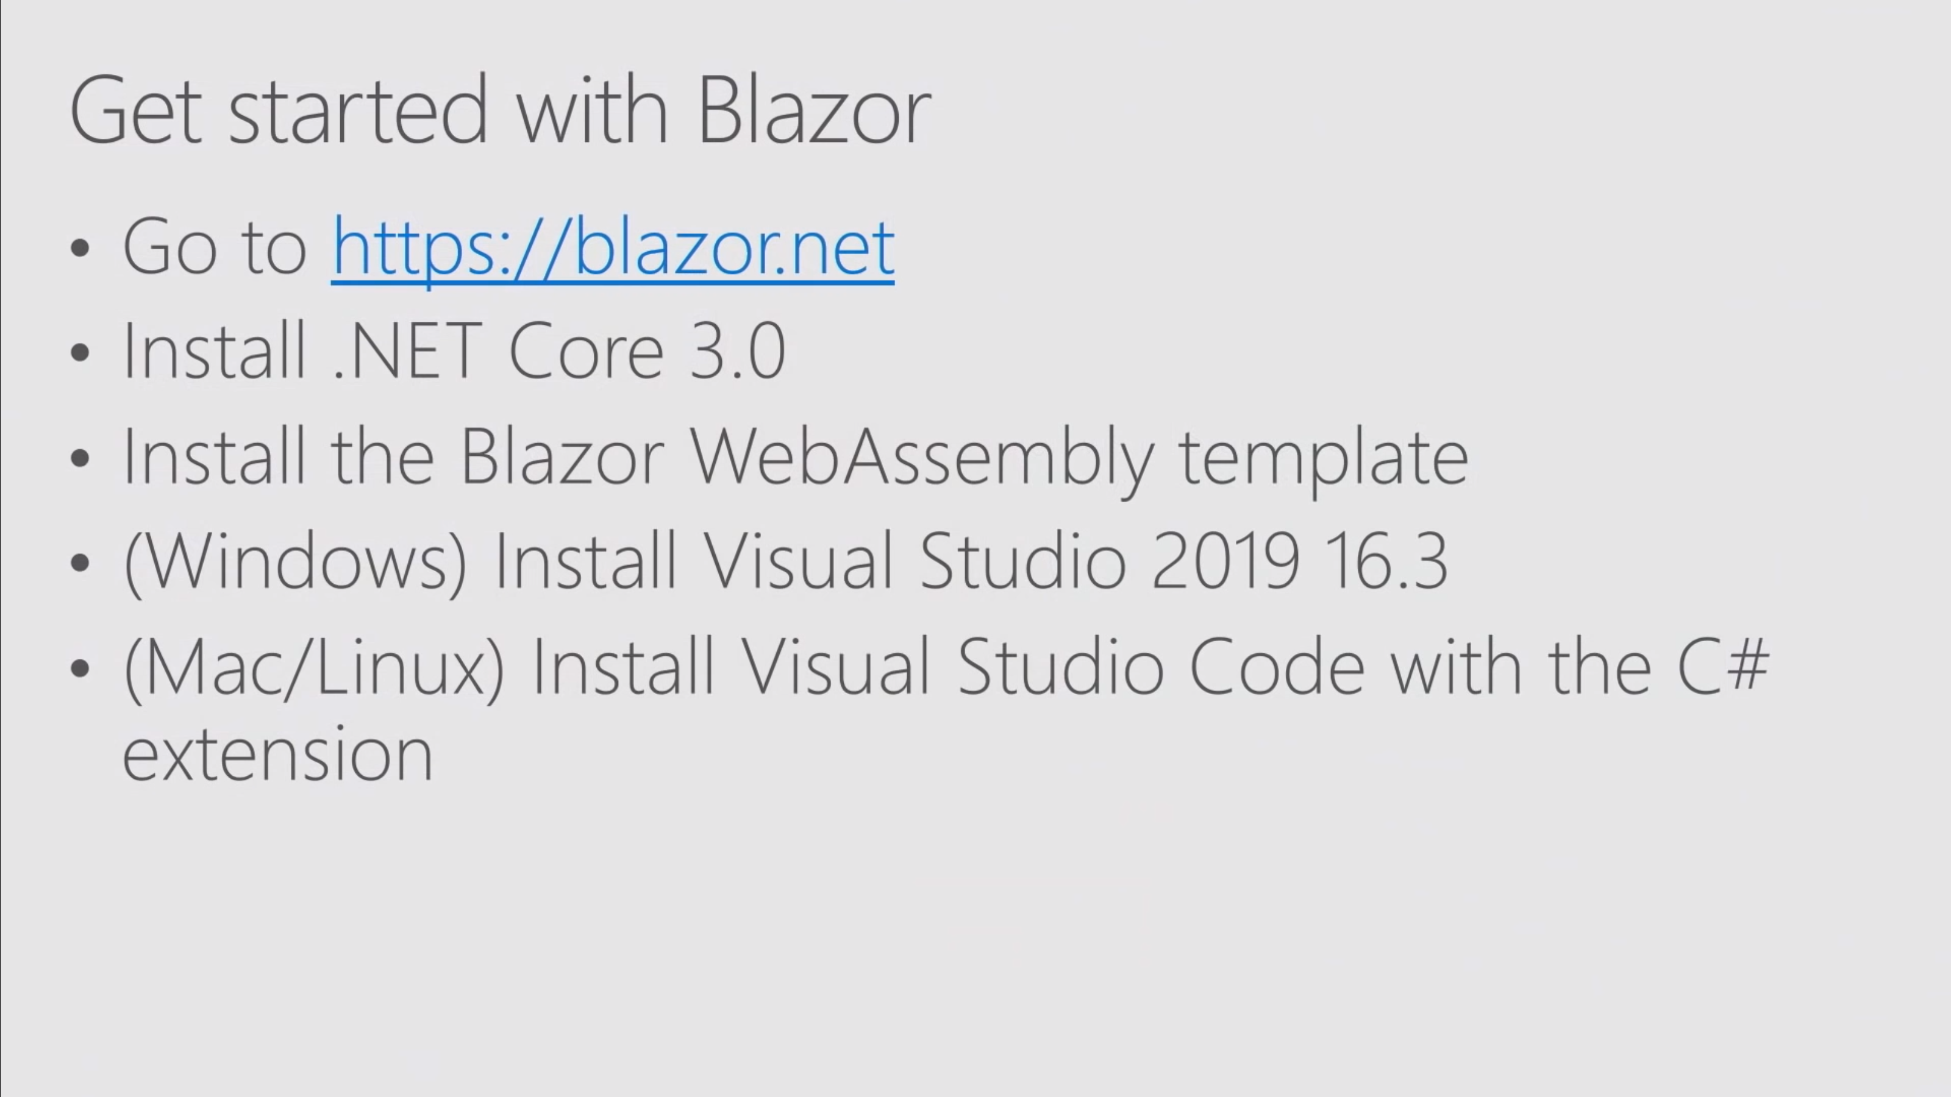
Notes:
More details: https://docs.microsoft.com/en-us/aspnet/core/blazor/get-started?view=aspnetcore-3.0&tabs=visual-studio
For Visual Studio Code:-
1. Install latest Blazor web assembly template run command “dotnet new -i Microsoft.AspNetCore.Blazor.Templates::3.0.0-preview9.19465.2”
2. To create Blazor Web Assembly project “dotnet new blazorwasm -o WebApplication1”
3. To create Balazor Server project “dotnet new blazorserver -o WebApplication1”
4. To run this project “dotnet run”

Slide 16


Slide 17
https://github.com/itorian/awesome-blazor

